Slide 1
Graph (A* and MST)
Week 9

Slide 2
Contents
Best-First Search
Minimum Spanning Tree
Other algorithms
Dijkstra's algorithm
Floyd–Warshall algorithm

Slide 3
Best-First Search
Best-first search is an improvement upon depth-first search
A heuristic is used to decide which node is explored next
A heuristic is a rule of thumb or best practice
We will look at heuristics in much more detail later
For example nodes are expanded in order of lowest cost

Slide 4
A* Search
The A* (A Star) search method is an example of a best-first search
Very good for route finding applications
In order for the search to work, two estimates must be available
How much a partial path has cost
An estimate (an under estimate) of how far is left to the goal state
E.g. a lower bound on how far to travel
The A* algorithm will find an optimal path without necessarily considering all the routes
Introduction to the A* Algorithm (redblobgames.com)

Slide 5
A* Search
The algorithm scores each partial path with the following function: f = g + h
Where g is the cost so far and h is the estimate of the cost to the goal state.
If h is always zero (i.e. we do not have any information about how far away the goal is), then the algorithm becomes similar to depth-first search
If g is always zero, then the algorithm is called a Greedy Search

Slide 6
A* Search Example
Expand S
{S,A} f=1+5=6
{S,B} f=2+6=8
Expand A
{S,B} f=2+6=8
{S,A,X} f=(1+4)+5=10
{S,A,Y} f=(1+7)+8=16
Expand B
{S,A,X} f=(1+4)+5=10
{S,B,C} f= (2+7)+4=13
{S,A,Y} f=(1+7)+8=16
{S,B,D} f= (2+1)+15=18
Expand X
{S,A,X,E} is the best path... (costing 7)
S
2
1
B
1
A
7
D
4
C
X
7
12
5
Y
2
3
E
Values for h:
A:5, B:6, C:4, D:15, X:5, Y:8

Slide 7
Minimum Spanning Trees
A spanning tree is a sub-graph that is also a tree (no cycles) that contains all of the nodes of the super-graph
The edges can only come from the super-graph
A graph may have many spanning trees
The cost of a spanning tree is the sum of all the edge weights
A minimum spanning tree (MST - there may be many) is the spanning tree with the minimum cost

Slide 8
Minimum Spanning Trees
1
A
B
1
A
B
6
2
Graph
3
C
5
2
C
4
1
1
D
E
2
D
E
2
A
B
Minimum
Spanning Tree,
Cost = 6
6
2
C
4
1
D
E
Spanning Tree, Cost = 13

Slide 9
Prim’s Algorithm for MST
Algorithm 4. PrimsMST(G=(V,E))
Input: G- a weighted graph (V- vertices, E- Edges)
1) Let x be a random node from V
2) Let Vnew = {x}
3) Let Enew = {}
4) While Vnew ≠ V
5) Choose an edge (u,v) with minimal weight,
such that u ∈ Vnew and v ∉ Vnew
6) Vnew = Vnew ∪ {v}
7) Enew = Enew ∪ {(u,v)}
8) WhileEnd
Output: Gnew = (Vnew,Enew)
Complexity O(n²) where n is the number of nodes

Slide 10
Graph Representation
We can also use a 2D table to represent a graph
Node
A
B
C
D
B
0 | 2 | 5 | 0
2 | 0 | 4 | 8
5 | 4 | 0 | 6
0 | 8 | 6 | 0
2
A
A
B
4
8
5
D
C
C
6
D

Slide 11
Application
B
2
A
The Travelling Salesman Problem
Node
A
B
C
D
4
8
5
0 | 2 | 5 | 0
2 | 0 | 4 | 8
5 | 4 | 0 | 6
0 | 8 | 6 | 0
D
A
C
6
B
C
D
Travel to all nodes (cities) : A ➔ B ➔ D ➔ C ➔ A
Distance : 2 + 8 + 6 + 5 = 21

Slide 12
Applications of MST
Cancer imaging
The British Columbia Cancer Research centre uses them to describe the arrangements of nuclei in skin cells
Detecting actin fibres in cell images
A biomedical image analysis application
MSTs used for understanding the large-scale structure of the universe

Slide 13
Other “Famous” Graph Algorithms
Dijkstra's algorithm
Shortest path algorithm similar to A*
Given a start and a goal the algorithm finds the shortest path between the two points by computing a series of shortest paths
Used in network routing
Complexity O(n²) where n is the number of nodes
Floyd–Warshall algorithm
This algorithm computes how far each node is from every other node
Computes 1-step paths, 2-step paths, etc...
Is it shorter to go to a node via a node rather than directly to it?
It does not return the paths
Complexity O(n³) where n is the number of nodes

Slide 14
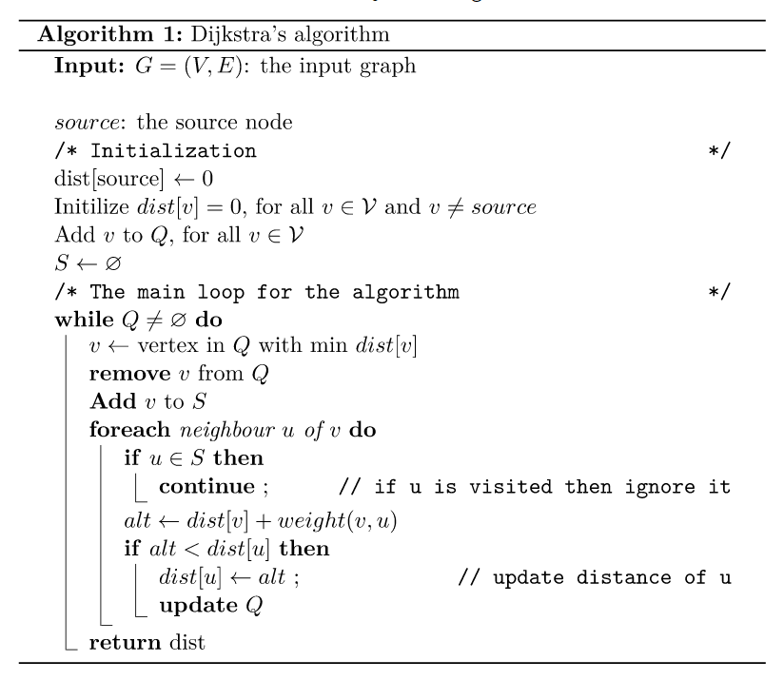
Dijkstra's algorithm

Slide 15
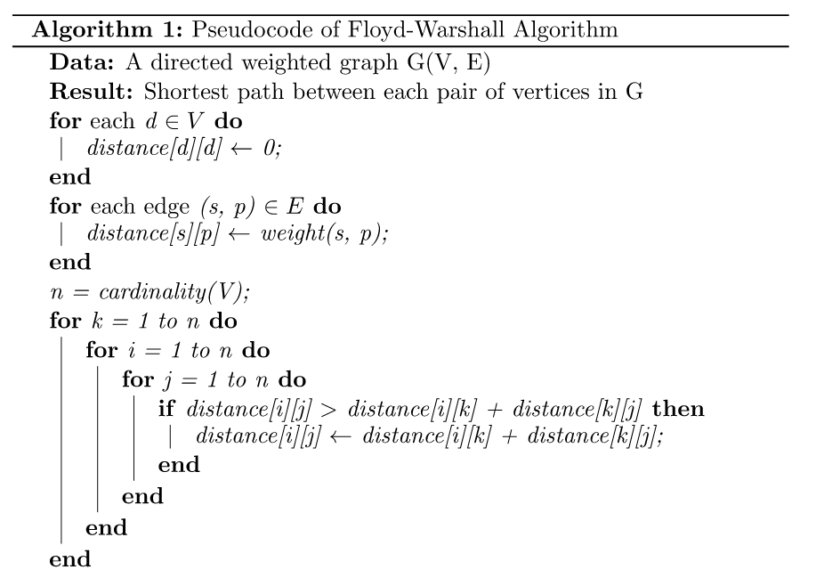
Floyd–Warshall algorithm
C
B
A
A B C
A
B
C
0 | 2 | 3
6 | 0 | 5
2 | 4 | 0
B to C : cost(B to A) + cost(A to C)
C to B : cost(C to A) + cost(A to B)
A to C : cost(A to B) + cost(B to C)

